Slide 1
Chapter 7
Inference for Means
Lecture Slides
Introduction to the Practice of Statistics
Tenth Edition
David S. Moore George P. McCabe
Bruce Craig

Slide 2
Chapter 7
Inference for Means
7.1 Inference for the Mean of a Population
7.2 Comparing Two Means
7.3 Sample Size Calculations

Slide 3
7.1 Inference for the Mean of a Population
The t distributions
One-sample t confidence interval
One-sample t test
Matched pairs t procedures
Robustness of the t procedures

Slide 4
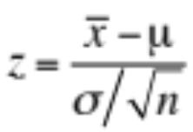
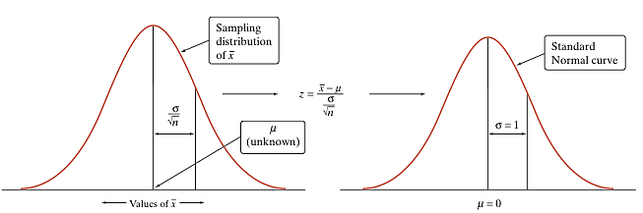
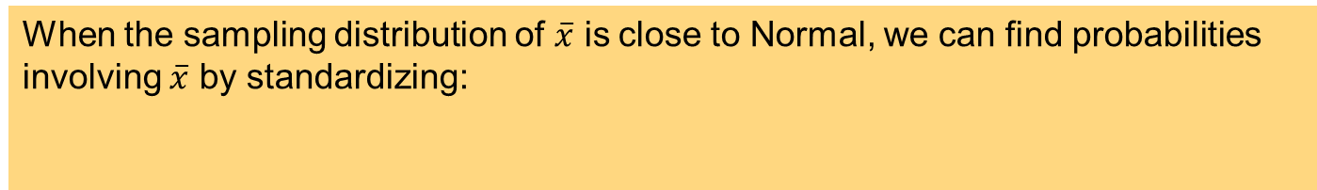
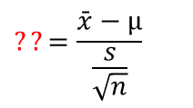
The t Distributions 1
When the sampling distribution of $\overline{x}$ is close to Normal, we can find probabilities involving $\overline{x}$ by standardizing:
When we don’t know σ, we can estimate it using the sample standard deviation s. What happens when we standardize?
$$??=\frac{\bar{x}−μ}{\frac{s}{\sqrt{n}}}$$
This new statistic does not have a Normal distribution.

Slide 5
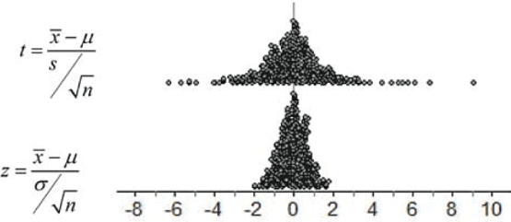
The t Distributions 2
When we standardize based on the sample standard deviation s, the statistic has a new distribution called a t distribution.
The t distribution has a shape similar to that of the standard Normal curve in that it is symmetric with a single peak at 0.
However, it differs from the Normal curve in that it has more area in the tails.
However, there is a different t distribution for each sample size, specified by its degrees of freedom (df).

Slide 6
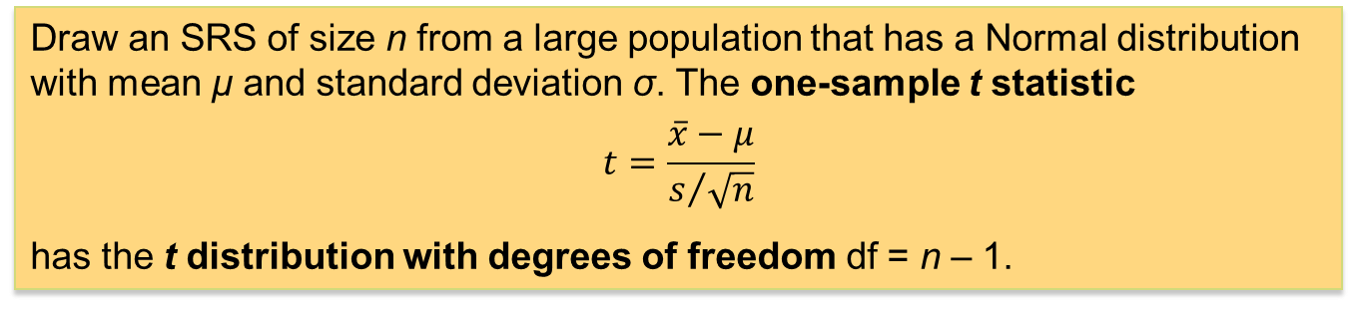
The t Distributions 3
When we perform inference about a population mean µ using a t distribution, the appropriate degrees of freedom are found by subtracting 1 from the sample size n, making df = n – 1.
The t Distributions: Degrees of Freedom
Draw an SRS of size n from a large population that has a Normal distribution with mean µ and standard deviation σ. The one-sample t statistic
$$t=\frac{\overline{x}−μ}{s/{\sqrt{n}}}$$
has the t distribution with degrees of freedom df = n – 1.

Slide 7
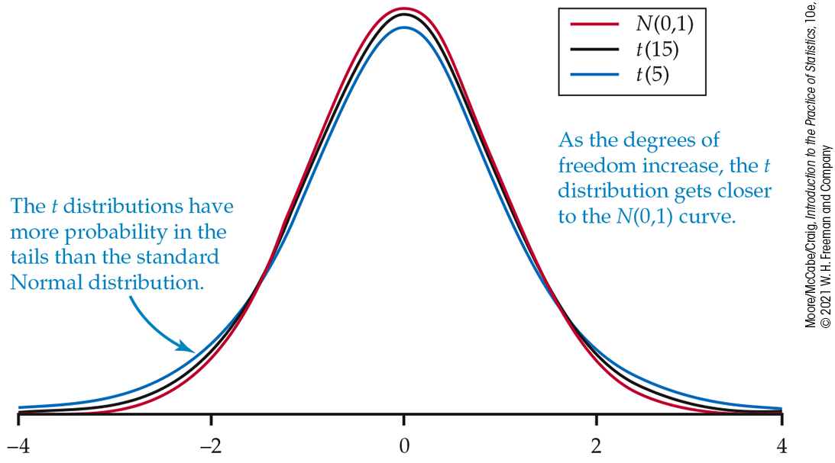
The t Distributions 4
When we compare the density curves of the standard Normal distribution and t distributions, several facts are apparent:
The density curves of the t distributions are similar in shape to the standard Normal curve.
The spread of the t distributions is a bit larger than that of the standard Normal distribution.
The t distributions have more probability in the tails and less in the center than does the standard Normal distribution.
As the degrees of freedom increase, the t density curve becomes ever closer to the standard Normal curve.
We can use Table D in the back of the text to determine critical values t* for t distributions with different degrees of freedom.

Slide 8
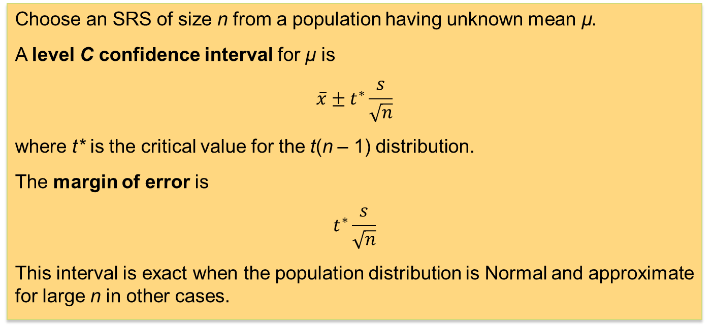
One-Sample t Confidence Interval
The one-sample t interval for a population mean is similar in both reasoning and computational detail to the one-sample z interval for a population mean.
The One-Sample t Interval for a Population Mean
Choose an SRS of size n from a population having unknown mean µ.
A level C confidence interval for µ is
$$\overline{x}±t^{∗}\frac{s}{\sqrt{n}}$$
where t* is the critical value for the t(n – 1) distribution.
The margin of error is
$$t^{∗}\frac{s}{\sqrt{n}}$$
This interval is exact when the population distribution is Normal and approximate for large n in other cases.

Slide 9
Using Table D
Suppose you want to construct a 95% confidence interval for the mean µ of a Normal population based on an SRS of size n = 12. What critical t* should you use?
Upper-tail probability p
df | 0.05 | 0.025 | 0.02 | 0.01
10 | 1.812 | 2.228 | 2.359 | 2.764
11 | 1.796 | 2.201 | 2.328 | 2.718
12 | 1.782 | 2.179 | 2.303 | 2.681
z* | 1.645 | 1.960 | 2.054 | 2.326
 | 90% | 95% | 96% | 98%
 | Confidence level C
In Table D, we consult the row corresponding to df = n – 1 = 11.
We move across that row to the entry that is directly above the 95% confidence level.
The desired critical value is t * = 2.201.

Slide 10
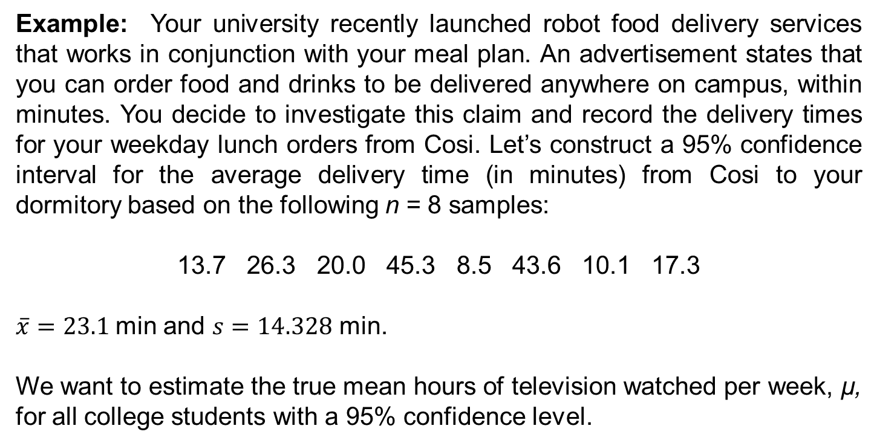
One-Sample t Confidence Interval (1 of 3)
Example: Your university recently launched robot food delivery services that works in conjunction with your meal plan. An advertisement states that you can order food and drinks to be delivered anywhere on campus, within minutes. You decide to investigate this claim and record the delivery times for your weekday lunch orders from Cosi. Let’s construct a 95% confidence interval for the average delivery time (in minutes) from Cosi to your dormitory based on the following n = 8 samples:
13.7 26.3 20.0 45.3 8.5 43.6 10.1 17.3
$\overline{x}=23.1$min and $s=14.328$ min.
We want to estimate the true mean hours of television watched per week, µ, for all college students with a 95% confidence level.

Slide 11
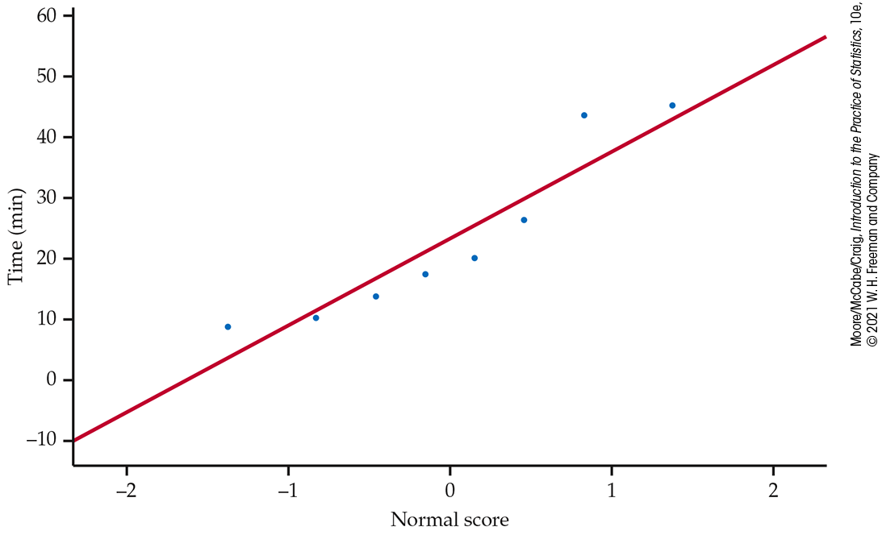
One-Sample t Confidence Interval (2 of 3)
If these conditions are met, we can use a one-sample t interval to estimate µ.
Random: We are told that the data come from a random sample of eight college students from the population of all college students.
Normal: Because the sample size is small (n < 30), we must check whether it is reasonable to believe that the population distribution is Normal. Examine the distribution of the sample data.
With no extreme outliers, this graph suggests no severe departure from Normality.
Independent: Because we are sampling without replacement, we must assume that the population is much, much larger than the sample. It is obvious that there are many thousands of college students in the population.

Slide 12
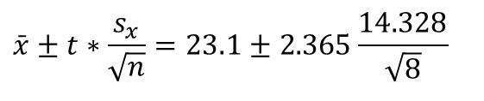
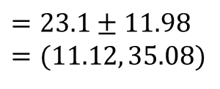
One-Sample t Confidence Interval (3 of 3)
Example: We have calculated the mean and standard deviation of the eight students in the sample.
$$\bar{x}=23.1 \text{hours} \text{and} s=14.328 \text{hours}$$
Upper-tail probability p
df | 0.05 | 0.025 | 0.02
6 | 1.943 | 2.447 | 2.612
7 | 1.895 | 2.365 | 2.517
8 | 1.860 | 2.306 | 2.449
 | 90% | 95% | 96%
 | Confidence level C
Because n = 8, we use the t distribution with df = 7 to find the critical value.
From Table D, we find t* = 2.365.
Therefore, the 95% confidence interval for µ is
$$\bar{x}±t∗\frac{s_{x}}{\sqrt{n}}=23.1±2.365\frac{14.328}{\sqrt{8}}$$
$$=23.1±11.98 \\ =(11.12, 35.08)$$
We are 95% confident that the interval from 11.12 to 35.08 min captures the true mean delivery time from Cosi to your dormitory.

Slide 13
One-Sample t Test (1 of 2)
Example: In the earlier delivery time example, the mean delivery time was 23.1 minutes. If you were to pick up an order from Cosi, it would take you 15 minutes to walk there and back. Focusing just on the time it takes to get an order, we might want to test whether the average robot delivery time differs from this 15.0 minutes.
We want to perform a test at the α = 0.05 significance level of
H₀: µ = 15.0
H_{a}: µ ≠ 15.0
where µ is the actual mean number of minutes it takes to make the delivery from Cosi to your dormitory.
Earlier, we checked that the conditions for inference were satisfied, so we can proceed to the t test.

Slide 14
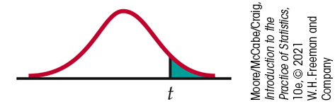
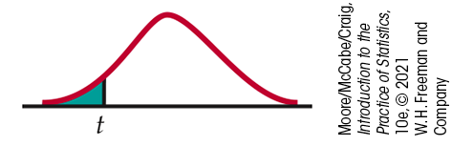
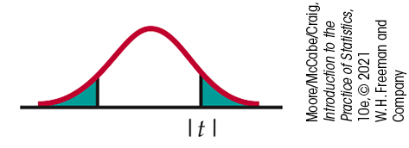

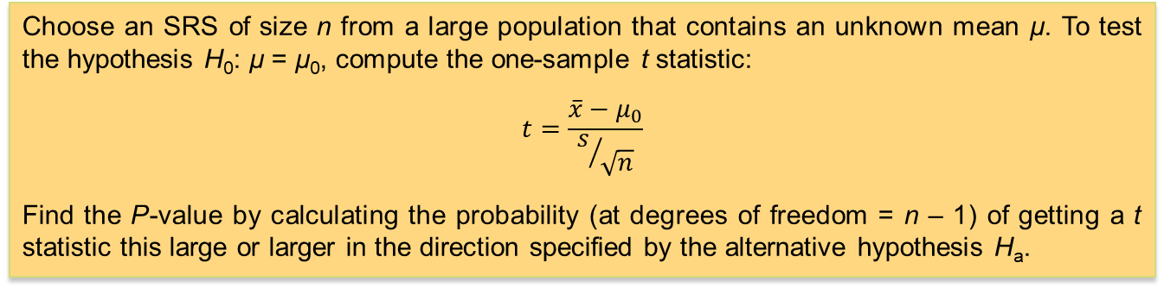


The One-Sample t Test
One-Sample t Test
Choose an SRS of size n from a large population that contains an unknown mean µ. To test the hypothesis H₀: µ = µ₀, compute the one-sample t statistic:
$$t=\frac{\overline{x}−μ_{0}}{s/{\sqrt{n}}}$$
Find the P-value by calculating the probability (at degrees of freedom = n – 1) of getting a t statistic this large or larger in the direction specified by the alternative hypothesis H_{a}.
$$H_{a}:μ>μ_{0} \text{is} P(T≥t)$$
$$H_{a}:μ<μ_{0} \text{is} P(T≤t)$$
$$H_{a}:μ≠μ_{0} \text{is} 2P(T≥\left|t\right|)$$
These P-values are exact if the population distribution is Normal and are approximately correct for large n in other cases.

Slide 15
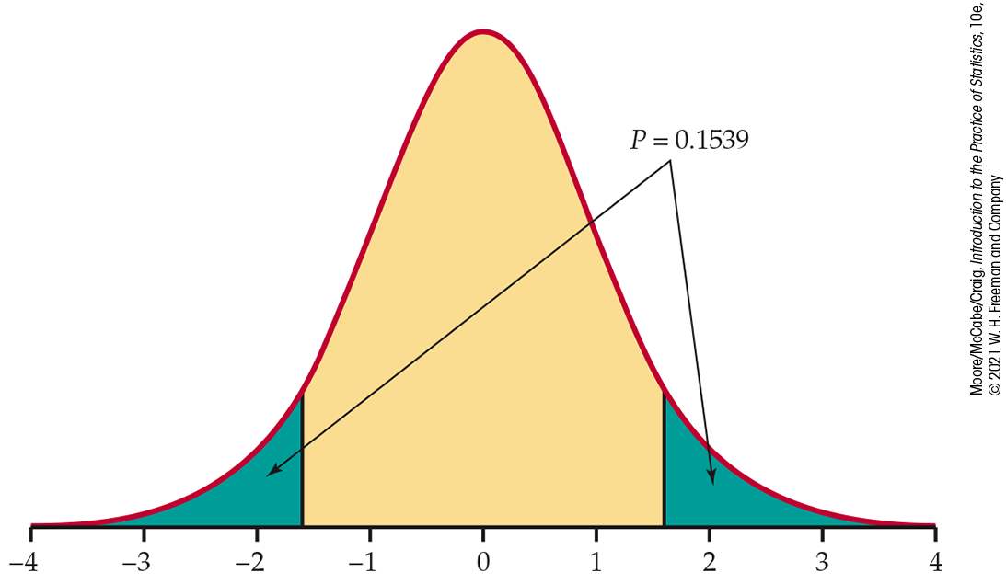

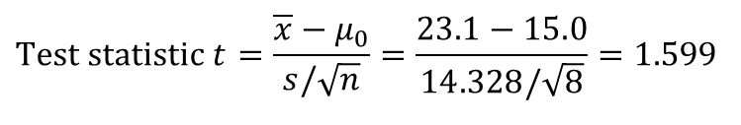
One-Sample t Test (2 of 2)
The sample mean and standard deviation are
$$\bar{x}=23.1\text{and} s=14.328$$
$$\text{Test} \text{statistic} t=\frac{\overline{x}−μ_{0}}{s/\sqrt{n}}=\frac{23.1−15.0}{14.328/\sqrt{8}}=1.599$$
P-value The P-value is twice the area to the right of t = 1.599 under the t distribution curve with df = 8 – 1 = 7.
With software, the P-value is 0.1539. Using table D, the P-value is between 2 x 0.05 = 0.10 and 2 x 0.10 = 0.20. Because this is greater than our α = 0.05 significance level, we fail to reject H₀. We don’t have enough evidence to conclude that the mean delivery time differs from 15 minutes.
Upper-tail probability p
df | 0.10 | 0.05 | 0.025
6 | 1.440 | 1.943 | 2.447
7 | 1.415 | 1.895 | 2.365
8 | 1.397 | 1.860 | 2.306
 | 80% | 90% | 95%
 | Confidence level C
Because we decided not to reject H₀, we might have made a Type II error (failing to reject H₀ when H₀ is false). If we did, then the mean delivery time from Cosi to your dormitory is actually not 15 minutes, even though we did not detect that with our significance test.

Slide 16
Matched Pairs t Procedures (1 of 3)
Comparative studies are more convincing than single-sample investigations. For that reason, one-sample inference is less common than comparative inference. Study designs that involve making two observations on the same individual, or one observation on each of two similar individuals, result in paired data.
When paired data result from measuring the same quantitative variable twice, as in the job satisfaction study, we can make comparisons by analyzing the differences in each pair. If the conditions for inference are met, we can use one-sample t procedures to perform inference about the mean difference µ.
Matched Pairs t Procedures
To compare the responses to the two treatments in a matched pairs design, find the difference between the responses within each pair. Then apply the one-sample t procedures to these differences.

Slide 17
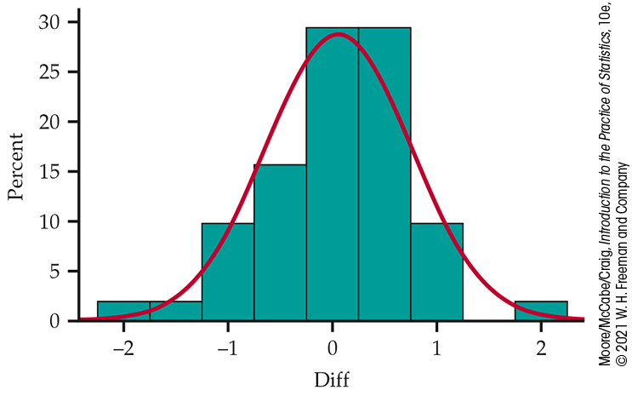
Matched Pairs t Procedures (2 of 3)
Example: The MeasureMind 3D MultiSensor metrology software is used by various companies to measure complex machine parts. GE Healthcare discovered that unchecking one software option reduced measurement time by 10%. To further investigate this, the researchers measured 51 parts using the software both with and without the option checked. (Order of checking the option or not was randomized.) The difference in the measurements with the option checked and unchecked was recorded.
We want to perform a test at the α = 0.05 significance level of
H₀: µ = 0
H_{a}: µ ≠ 0
where µ is the actual mean difference for the entire population of parts.
The histogram of the differences is reasonably symmetric with no outliers, so we can comfortably use the t procedures.

Slide 18

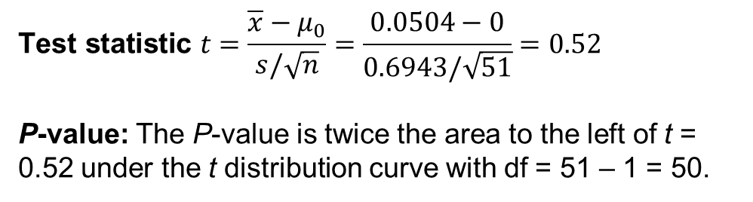
Matched Pairs t Procedures (3 of 3)
The sample mean and standard deviation are
$$\text{Test} \text{statistic} t=\frac{\overline{x}−μ_{0}}{s/\sqrt{n}}=\frac{0.0504−0}{0.6943/\sqrt{51}}=0.52$$
P-value: The P-value is twice the area to the left of t = 0.52 under the t distribution curve with df = 51 – 1 = 50.
The P-value is greater than 2 x 0.25 = 0.50. Because this is greater than our α = 0.05 significance level, we fail to reject H₀. We do not have enough evidence to conclude that unchecking the option has an impact on the measurement times.
Upper-tail probability p
df | 0.25 | 0.20 | 0.15
40 | 0.681 | 0.851 | 1.050
50 | 0.679 | 0.849 | 1.047
60 | 0.679 | 0.848 | 1.045
 | 50% | 60% | 70%
 | Confidence level C
However, a lack of statistical significance does not prove the null hypothesis is true. We may have made a Type II error. The company may want to consider a larger study to improve precision.

Slide 19
Robustness of t Procedures
A confidence interval or significance test is robust if the confidence level or P-value does not change very much when the conditions for use of the procedure are violated.
Using the t Procedures
Except in the case of small samples, the condition that the data are an SRS from the population of interest is more important than the condition that the population distribution is Normal.
Sample size at least 15: The t procedures can be used except in the presence of outliers or strong skewness.
Sample size less than 15: Use t procedures if the data appear close to Normal. If the data are clearly skewed or if outliers are present, do not use t.
Large samples: The t procedures can be used even for clearly skewed distributions when the sample is large, roughly n ≥ 40.

Slide 20
7.2 Comparing Two Means
The two-sample z statistic
The two-sample t procedures
The two-sample t confidence interval
The two-sample t significance test
Robustness of the two-sample procedures
Inference for small samples
Pooled two-sample t procedures

Slide 21
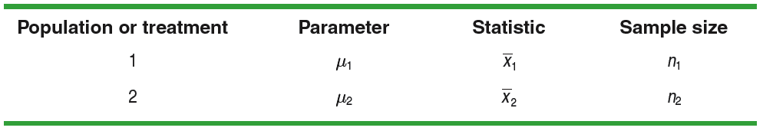
Two-Sample Problems
What if we want to compare the means of some quantitative variable for two populations, Population 1 and Population 2?
Our parameters of interest are the population means µ₁ and µ₂. The best approach is to take separate random samples from each population and to compare the sample means.
Suppose we want to compare the average effectiveness of two treatments in a completely randomized experiment. In this case, the parameters µ₁ and µ₂ are the true mean responses for Treatment 1 and Treatment 2, respectively. We use the mean response from each of the two groups to make the comparison. Here’s a table that summarizes this situation:

Slide 22
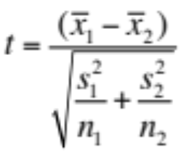
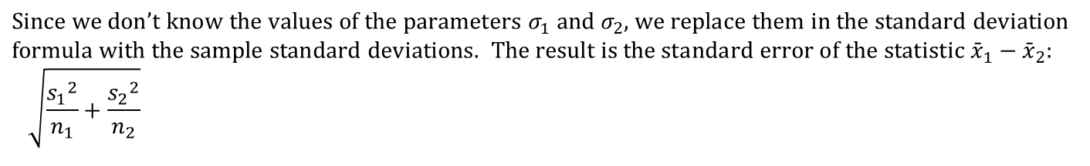
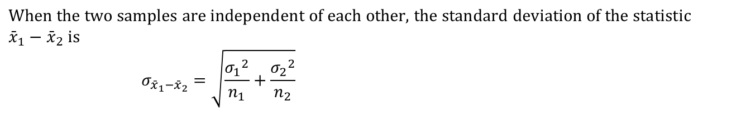
The Two-Sample t Procedures
$$\text{When} \text{data} \text{come} \text{from} \text{two} \text{random} \text{samples} \text{or} \text{two} \text{groups} \text{in} \text{a} \text{randomized} \text{experiment}\text{, }\text{the} \text{statistic} \\ {\bar{x}}_{1}−{\bar{x}}_{2} \text{is} \text{our} \text{best} \text{guess} \text{for} \text{the} \text{value} \text{of} μ_{1}−μ_{2}.$$
$$\text{When} \text{the} \text{two} \text{samples} \text{are} \text{independent} \text{of} \text{each} \text{other}\text{, }\text{the} \text{standard} \text{deviation} \text{of} \text{the} \text{statistic} \\ {\bar{x}}_{1}−{\bar{x}}_{2} \text{is} \\ σ_{{\bar{x}}_{1}−{\bar{x}}_{2}}=\sqrt{\frac{{σ_{1}}^{2}}{n_{1}}+\frac{{σ_{2}}^{2}}{n_{2}}}$$
$$\text{Since} \text{we} \text{don}\text{’}\text{t} \text{know} \text{the} \text{values} \text{of} \text{the} \text{parameters} σ_{1} \text{and} σ_{2}\text{, }\text{we} \text{replace} \text{them} \text{in} \text{the} \text{standard} \text{deviation} \\ \text{formula} \text{with} \text{the} \text{sample} \text{standard} \text{deviations}\text{. }\text{The} \text{result} \text{is} \text{the} standard error \text{of} \text{the} \text{statistic} {\bar{x}}_{1}−{\bar{x}}_{2}\text{: } \\ \sqrt{\frac{{s_{1}}^{2}}{n_{1}}+\frac{{s_{2}}^{2}}{n_{2}}}$$
We standardize the observed difference to obtain a t statistic that tells us how far the observed difference is from its mean in standard deviation units.
The two-sample t statistic has approximately a t distribution. We use technology to determine degrees of freedom OR we can use a conservative approach, using the smaller of n₁ – 1 and n₂ – 1 for the degrees of freedom.

Slide 23
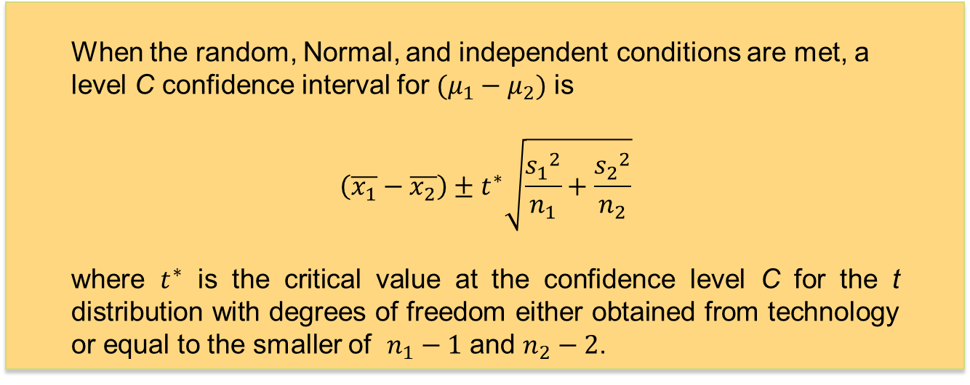
Confidence Interval for µ₁ – µ₂
Two-Sample t Interval for a Difference between Means
When the random, Normal, and independent conditions are met, a level C confidence interval for $(μ_{1}−μ_{2})$ is
$$\left(\overline{x_{1}}−\overline{x_{2}}\right)±t^{∗}\sqrt{\frac{{s_{1}}^{2}}{n_{1}}+\frac{{s_{2}}^{2}}{n_{2}}}$$
where $t^{∗}$ is the critical value at the confidence level C for the t distribution with degrees of freedom either obtained from technology or equal to the smaller of $n_{1}−1$ and $n_{2}−2$.

Slide 24
Two-Sample t Procedures (1 of 4)
Example: An educator believes that new directed reading activities in the classroom will help elementary school pupils improve some aspects of their reading ability. The educator arranges for a third-grade class of 21 students to take part in these activities for an 8-week period. A control classroom of 23 third-graders follows the same curriculum without the activities. At the end of the 8 weeks, all students are given a DRP test, which measures the aspects of reading ability that the treatment is designed to improve. The data follow.
Treatment group
24 | 61 | 59 | 46
43 | 44 | 52 | 43
58 | 67 | 62 | 57
71 | 49 | 54
43 | 53 | 57
49 | 56 | 33
Control group
42 | 33 | 46 | 37
43 | 41 | 10 | 42
55 | 19 | 17 | 55
26 | 54 | 60 | 28
62 | 20 | 53 | 48
37 | 85 | 42

Slide 25
Two-Sample t Procedures (2 of 4)
Our parameters of interest are
µ₁ = the true mean DRP score using the reading activities, and
µ₂ = the true mean DRP score without using the reading activities.
We want to estimate the difference µ₁ – µ₂ at a 95% confidence level.
We should use a two-sample t interval for µ₁ – µ₂ if the conditions are satisfied.
Random: It was impractical to assign students to classes in a school environment, so existing third-grade classes were used. The effect of the reading programs is therefore confounded with any other differences between the two classes. Extensive pretesting showed that the two classes were, on average, quite similar in reading ability at the beginning of the experiment. Further, the same teacher was used in both classes.

Slide 26
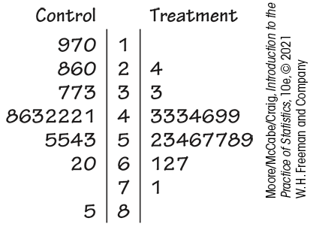
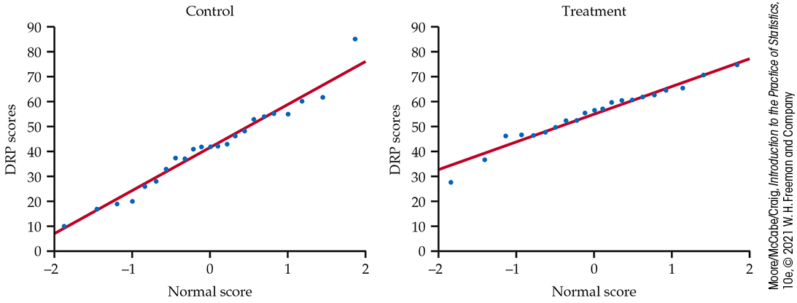
Two-Sample t Procedures (3 of 4)
Normal: The back-to-back stemplots suggest that there is a mild outlier in the control group but no deviation from Normality serious enough to forbid use of the t procedures.

Slide 27
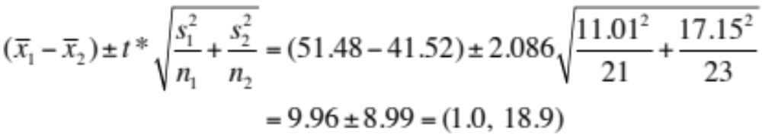
Two-Sample t Procedures (4 of 4)
Because the conditions are nearly satisfied, we can construct a two-sample t interval for the difference µ₁ – µ₂. We will use the conservative df = 21 – 1 = 20.
Upper-tail probability p
df | 0.05 | 0.025 | .02
19 | 1.729 | 2.093 | 2.205
20 | 1.725 | 2.086 | 2.197
21 | 1.721 | 2.080 | 2.189
 | 90% | 95% | 96%
 | Confidence level C
We are 95% confident that the interval from 1.0 to 18.9 captures the true difference in the DRP means for the two groups.

Slide 28
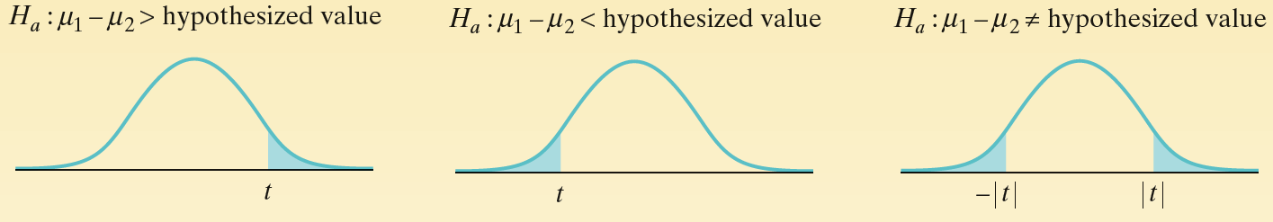
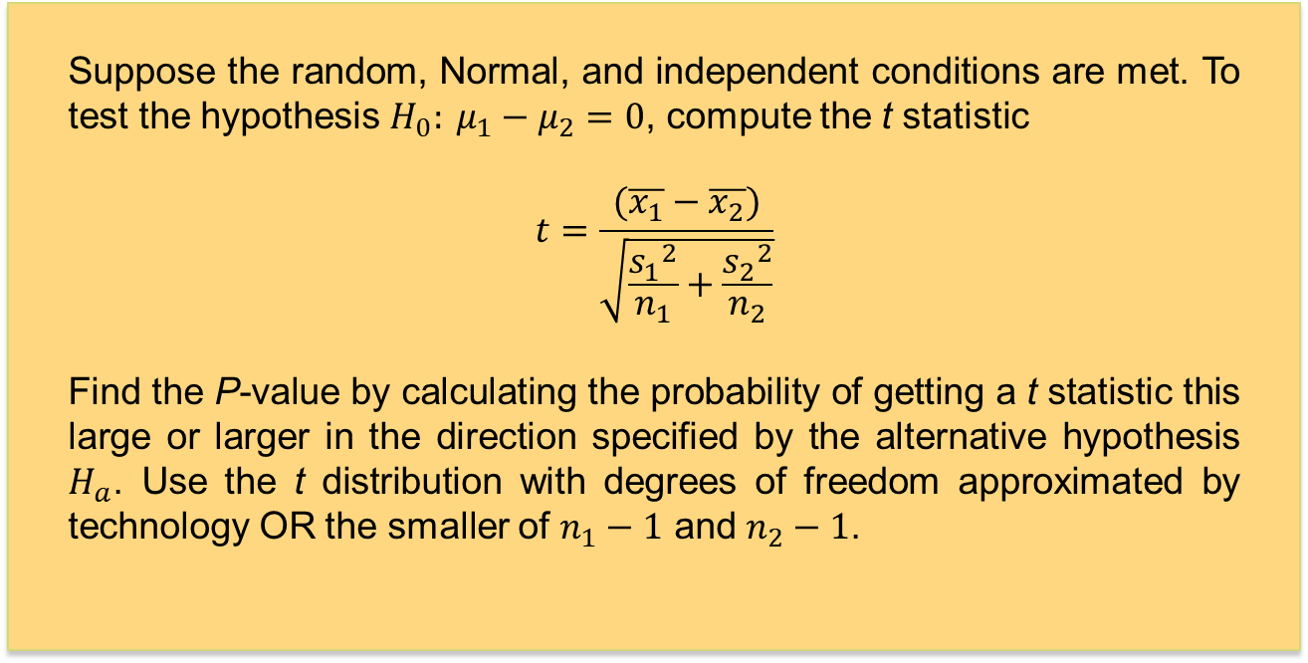
Two-Sample t Test (1 of 2)
Two-Sample t Test for the Difference between Two Means
Suppose the random, Normal, and independent conditions are met. To test the hypothesis $H_{0}: μ_{1}−μ_{2}=0$, compute the t statistic
$$t=\frac{(\overline{x_{1}}−\overline{x_{2}})}{\sqrt{\frac{{s_{1}}^{2}}{n_{1}}+\frac{{s_{2}}^{2}}{n_{2}}}}$$
Find the P-value by calculating the probability of getting a t statistic this large or larger in the direction specified by the alternative hypothesis $H_{a}$. Use the t distribution with degrees of freedom approximated by technology OR the smaller of $n_{1}−1$ and $n_{2}−1$.

Slide 29
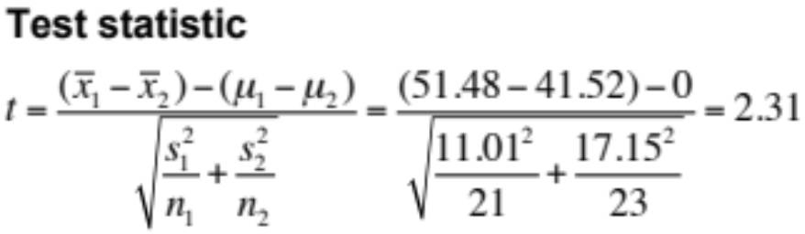
Two-Sample t Test (2 of 2)
Example: Consider the “directed reading activities” example again. As before, the conditions are nearly met, so we will carry out a two-sample t test for µ₁ – µ₂. We want to perform a test of H₀: µ₁ – µ₂ = 0 versus H_{a}: µ₁ – µ₂ > 0, where µ₁ = the true mean DRP score using the directed reading activities, and µ₂ = the true DRP score mean without using the directed reading activities. We will use α = 0.05.
Upper-tail probability p
df | 0.025 | 0.02 | 0.01
19 | 2.093 | 2.205 | 2.539
20 | 2.086 | 2.197 | 2.528
21 | 2.080 | 2.189 | 2.518
 | 95% | 96% | 98%
 | Confidence level C
P-value Using the conservative df = 21 – 1 = 20, we can use Table D to show that the P-value is between 0.01 and 0.02.
Because the P-value is smaller than α = 0.05, we reject H₀. The experiment provides convincing evidence that directed reading activities improve the DRP score.

Slide 30
Robustness of the Two-Sample Procedures
The two-sample t procedures are more robust than the one-sample t methods, particularly when the distributions are not symmetric.
Using the t Procedures
Except in the case of small samples, the condition that the data are SRSs from the populations of interest is more important than the condition that the population distributions are Normal.
Sum of the sample sizes less than 15: Use t procedures if the data appear close to Normal. If the data are clearly skewed or if outliers are present, do not use t.
Sum of the sample size at least 15: The t procedures can be used except in the presence of outliers or strong skewness.
Large samples: The t procedures can be used even for clearly skewed distributions when the sum of the sample sizes is large.

Slide 31
Inference for Small Samples
When we do not have enough observations to examine distribution shapes, only extreme outliers will stand out. These small samples require special care.
Features of small samples
The power of significance tests tends to be low.
Margins of error of confidence intervals tend to be large.
If an effect is large, it should still be evident, even with small sample sizes.

Slide 32
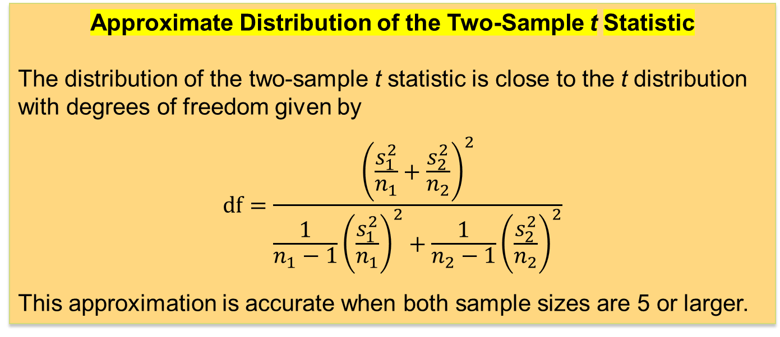
Software Approximation for the Degrees of Freedom
The exact distribution of the two-sample t statistic is not a t distribution. The distribution changes as the unknown population standard deviations change. However, an excellent approximation is available.
Approximate Distribution of the Two-Sample t Statistic
The distribution of the two-sample t statistic is close to the t distribution with degrees of freedom given by
$$df=\frac{{\left(\frac{s_{1}^{2}}{n_{1}}+\frac{s_{2}^{2}}{n_{2}}\right)}^{2}}{\frac{1}{n_{1}−1}{\left(\frac{s_{1}^{2}}{n_{1}}\right)}^{2}+\frac{1}{n_{2}−1}{\left(\frac{s_{2}^{2}}{n_{2}}\right)}^{2}}$$
This approximation is accurate when both sample sizes are 5 or larger.

Slide 33
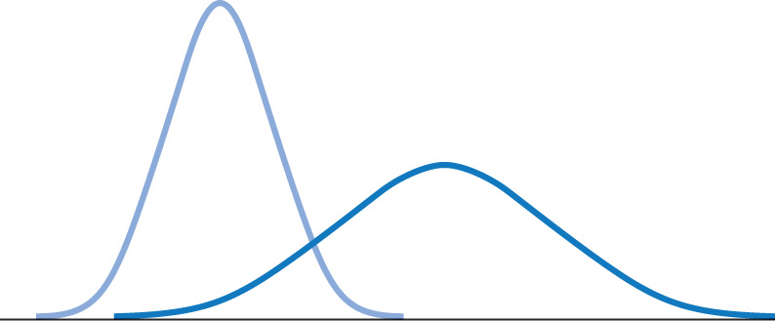
Pooled Two-Sample Procedures 1
There are two versions of the two-sample t-test: one assuming equal variance (“pooled two-sample test”) and one not assuming equal variance (“unequal” variance, as we have studied) for the two populations. They have slightly different formulas and degrees of freedom.
The pooled (equal variance) two-sample t test was often used before computers, because it has exactly the t distribution for degrees of freedom n₁ + n₂ − 2.
However, the assumption of equal variances is difficult to check; thus, the unequal variance test is safer.
Two Normally distributed populations
with unequal variances

Slide 34
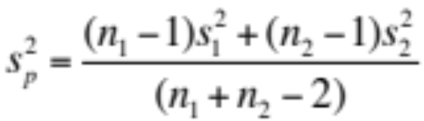
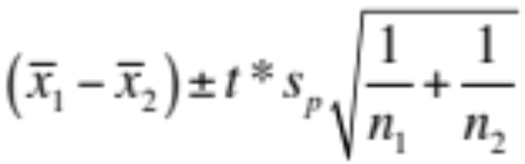
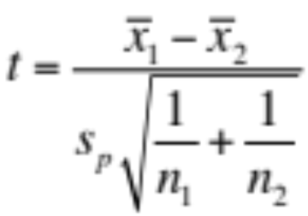
Pooled Two-Sample Procedures 2
Suppose both populations are Normal and they have the same standard deviations. The pooled estimator of σ² is
A level C confidence interval for µ₁ − µ₂ is
where the degrees of freedom for t* are n₁ + n₂ − 2.
To test the hypothesis H₀: µ₁ = µ₂ against a
one-sided or a two-sided alternative, compute the pooled two-sample t statistic for the t(n₁ + n₂ − 2) distribution.

Slide 35
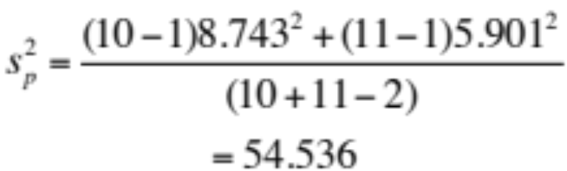

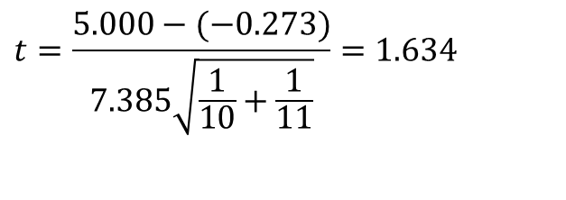
Pooled Two-Sample Procedures
Example: Does increasing the amount of calcium in our diet reduce blood pressure? A randomized comparative experiment gave one group of 10 men a calcium supplement for 12 weeks and a control group of 11 men a placebo that appeared identical. The summary statistics are given below for the decreases in blood pressure.
Group | n | Mean | s
Calcium | 10 | 5.000 | 8.743
Placebo | 11 | –0.273 | 5.901
To test the hypothesis H₀: µ₁ = µ₂ against a
one-sided or a two-sided alternative, compute the pooled two-sample t statistic for the t(n₁ + n₂ − 2) distribution.
$$t=\frac{5.000−(−0.273)}{7.385\sqrt{\frac{1}{10}+\frac{1}{11}}}=1.634$$
The P-value from statistical software is p = 0.059, and we conclude that there is some evidence but not convincing evidence.

Slide 36
7.3 Sample Size Calculations
Sample size for confidence intervals
Power of a significance test
Inference for non-Normal populations
Use of a distribution-free procedure

Slide 37
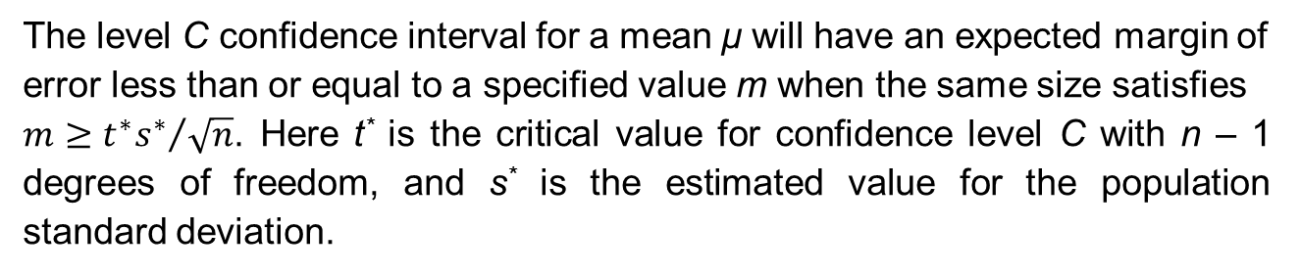
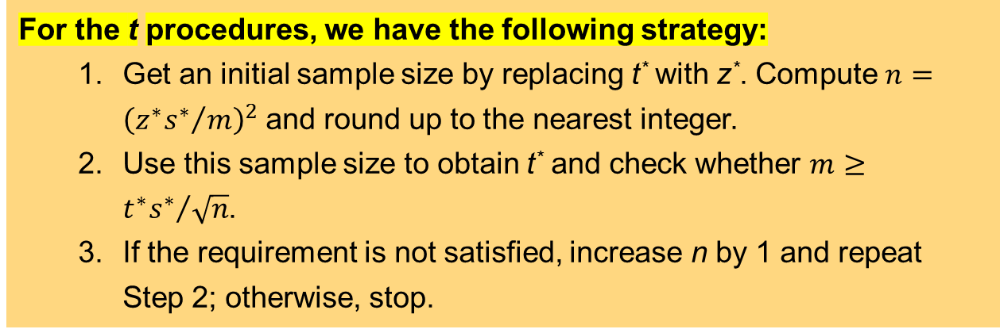
Choosing the Sample Size
A wise user of statistics does not plan for inference without at the same time planning data collection.
Our primary method of choosing sample sizes for studies involves specifying the desired margin of error.
The level C confidence interval for a mean μ will have an expected margin of error less than or equal to a specified value m when the same size satisfies
${m≥t^{∗}s^{∗}}/{\sqrt{n}}$. Here t* is the critical value for confidence level C with n – 1 degrees of freedom, and s* is the estimated value for the population standard deviation.
For the t procedures, we have the following strategy:
  Get an initial sample size by replacing t* with z*. Compute $n={\left({z^{∗}s^{∗}}/m\right)}^{2}$ and round up to the nearest integer.
  Use this sample size to obtain t* and check whether $m≥{t^{∗}s^{∗}}/{\sqrt{n}}$.
  If the requirement is not satisfied, increase n by 1 and repeat Step 2; otherwise, stop.

Slide 38
The Power of the One-Sample t test
The power of the one-sample t test for a specific alternative value of the population mean µ, assuming a fixed significance level α, is the probability that the test will reject the null hypothesis when the alternative value of the mean is true.
Calculation of the exact power of the t test is a bit complex. But an approximate calculation that acts as if σ were known is almost always adequate for planning a study. This calculation is very much like that for the z test.
When guessing σ, it is always better to err on the side of a standard deviation that is a little larger rather than smaller. We want to avoid failing to find an effect because we did not have enough data.

Slide 39
The Power of the Two-Sample t Test 1
Assume that the significance level of a two-sample t test is fixed at α. Then the power of the test for a specific alternative value of the difference in population means (µ₁ − µ₂) is the probability that the test will lead to our rejecting the null hypothesis when the alternative is true.
The basic concept is like that for the one-sample t test. The exact method involves the noncentral t distribution. Calculations are carried out with software.
One needs information from a pilot study or from previous research to calculate an expected power for a t test, which allows one to smartly plan a study.

Slide 40
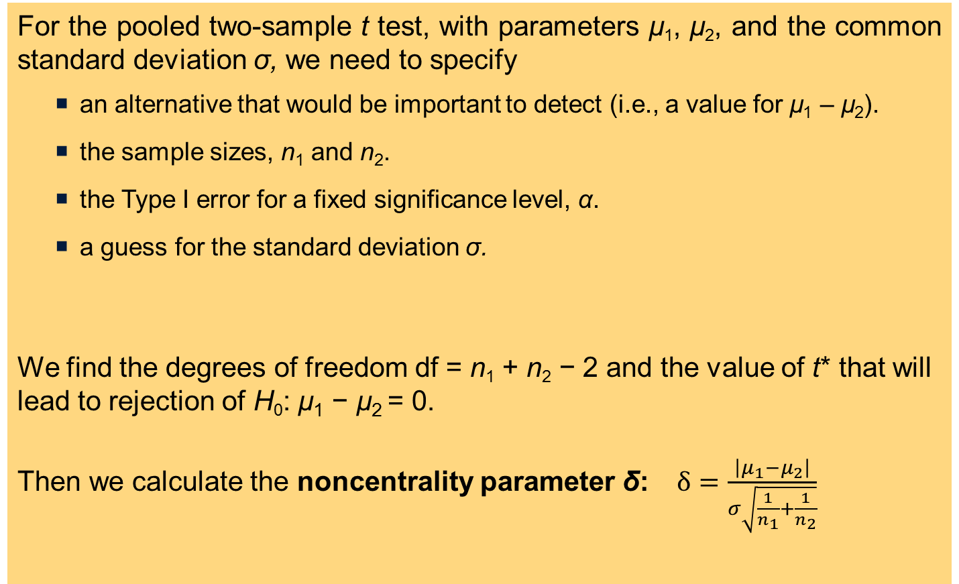
The Power of the Two-Sample t Test 2
For the pooled two-sample t test, with parameters µ₁, µ₂, and the common standard deviation σ, we need to specify
  an alternative that would be important to detect (i.e., a value for µ₁ – µ₂).
  the sample sizes, n₁ and n₂.
  the Type I error for a fixed significance level, α.
  a guess for the standard deviation σ.
We find the degrees of freedom df = n₁ + n₂ − 2 and the value of t* that will lead to rejection of H₀: µ₁ − µ₂ = 0.
Then we calculate the noncentrality parameter δ: $δ=\frac{\left|μ_{1}−μ_{2}\right|}{σ\sqrt{\frac{1}{n_{1}}+\frac{1}{n_{2}}}}$

Slide 41
Inference for Non-Normal Distributions
What if the population is clearly non-Normal and the sample is small?
If the data are skewed, one can attempt to transform the variable to bring it closer to Normality (e.g., logarithm transformation). The t procedures applied to transformed data are often quite accurate for even moderate sample sizes.
A distribution other than a Normal distribution might describe the data well. Many non-Normal models have been developed to provide inference procedures, too.
One can always use a distribution-free (“nonparametric”) inference procedure (see Chapter 15) that does not assume any specific distribution for the population. However, such a procedure is usually less powerful than distribution-driven tests (e.g., the t test).

Slide 42
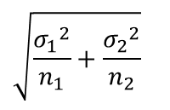
The Power of the Two-Sample t Test 3
Last, we find the power as the probability that a noncentral t random variable with degrees of freedom df and noncentrality parameter δ will be greater than t*:
  In SAS this is 1-PROBT(tstar, df, delta). There are also several free online tools that calculate power.
  Without access to software, we can approximate the power to be P(z > t* − δ), which is the probability that a standard Normal random variable is greater than t* − δ. Table A may be used to find P(z > t* − δ).
For a test with unequal variances, we can simply use the conservative degrees of freedom, but we need to guess both standard deviations and combine them for the guessed standard error:
$$\sqrt{\frac{{σ_{1}}^{2}}{n_{1}}+\frac{{σ_{2}}^{2}}{n_{2}}}$$

Slide 43
The Sign Test
Calculate the matched difference for each individual in the sample.
Ignore pairs with difference 0.
The number of trials n is the count of the remaining pairs.
The test statistic is the count X of pairs with a positive difference.
P-values for X are obtained from the binomial B(n, 1/2) distribution.

Slide 44
Chapter 7
Inference for Means (Review)
7.1 Inference for the Mean of a Population
7.2 Comparing Two Means
7.3 Sample Size Calculations

